Slide 1
Rasmilla’s First Day of School
A choose your own adventure story

Slide 2
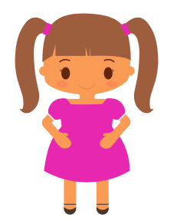
You are Rasmilla – a 12 year old girl who has recently moved to Canada from Nepal.
It is your first day of school in your new country. You’re nervous but also excited.

Slide 3
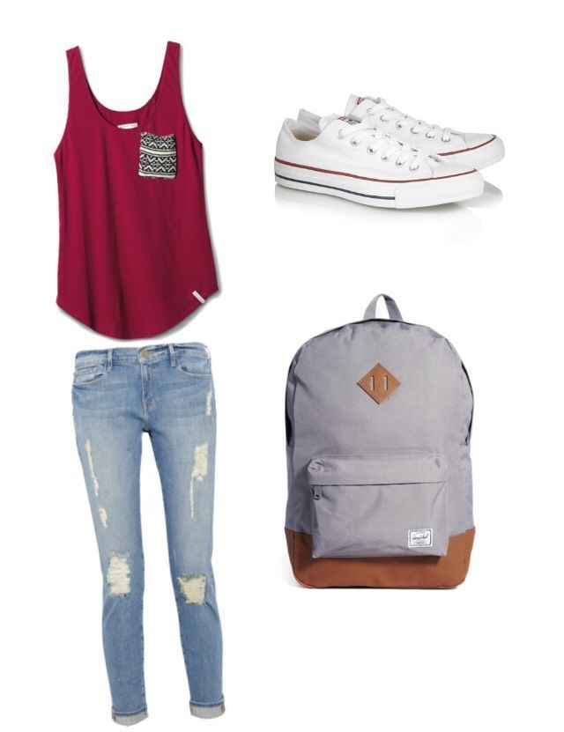
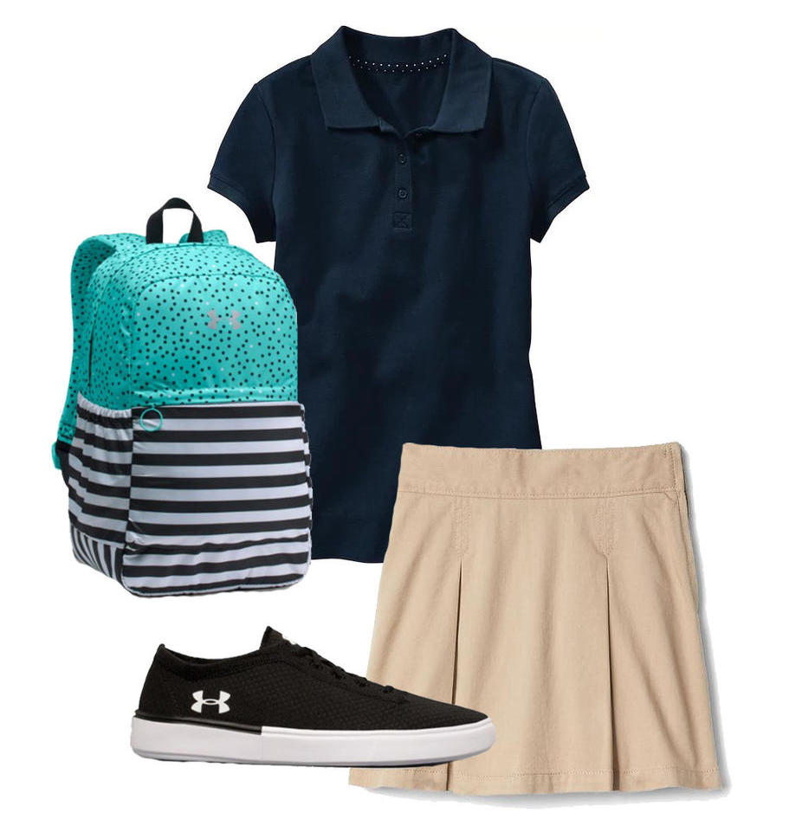
First thing first, you need to pick your outfit – which outfit do you like best?

Slide 4
You look great! I love your shirt.

Slide 5
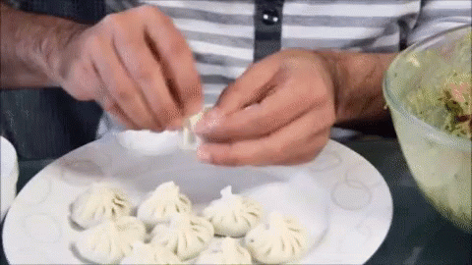
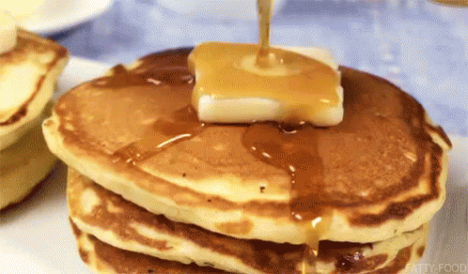
Time to head downstairs – you don’t want to be late. Your mom is cooking you breakfast… what is she cooking?
She’s cooking Momo – a delicious traditional Nepali breakfast.
She’s cooking pancakes with maple syrup – a breakfast many Canadians love!

Slide 6
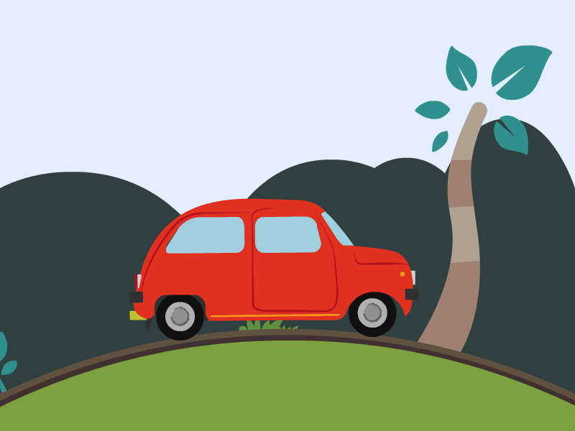
Great choice! You’re going to have lots of energy for school. Time to head out the door – how are you getting there?
You’re getting on the school bus for the first time.
Your dad will drop you off on his way to work.

Slide 7
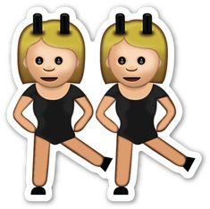
You walk onto the bus – what do you do?
Sit with a new friend.
Sit by yourself.

Slide 8
That’s okay – maybe later in the day you’ll feel like socializing with some of your new classmates.

Slide 9
Awesome! You’ve made it to school! Your teacher introduces you to the class and shows you to your seat. The first subject of the day is English, and we’re doing a real-aloud of your favourite book. What book is it?

Slide 10
That’s my favourite too! The teacher asks if there are any volunteers to read the book aloud – what do you do?
Raise your hand confidently and volunteer to read
Avert eyes and look down at the floor – there’s no way you’re reading in front of your new classmates.

Slide 11
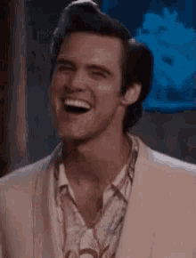
That’s great you decided to read in front of your class - you did a awesome job!

Slide 12
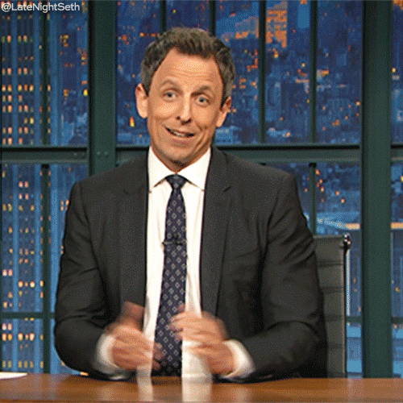
That is totally understandable – everyone is nervous on the first day of school. Maybe tomorrow you’ll be feeling more confident in your reading-aloud skills.

Slide 13
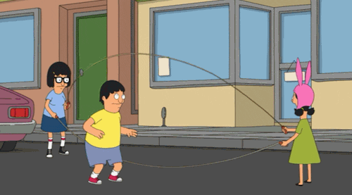
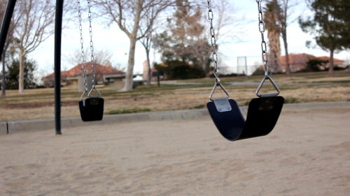
The bell rings – it’s time for recess… what do you want play?
Double dutch – that was your favourite back in Nepal.
Swings – that way you don’t need to talk to anyone.

Slide 14
You walked up to a group of girls playing double dutch – they encourage to join in and play along – they’re so nice!

Slide 15
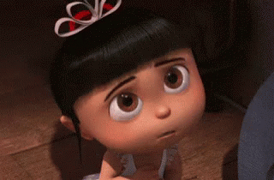
You walk over to the swings and watch your classmates from afar – maybe next time you’ll chose to play with them instead.

Slide 16
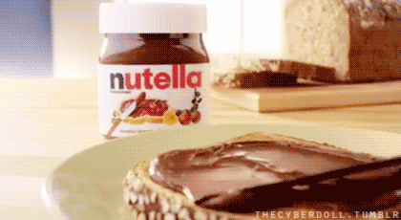
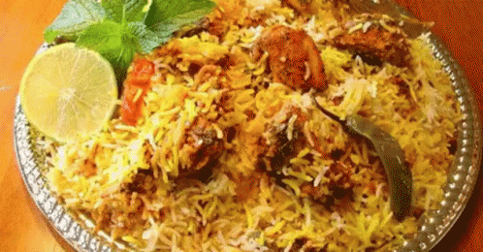
The bell rings again – it’s time to come inside for lunch. You and your classmates sit down to eat lunch. You peer inside your lunch bag and see…
A Nutella & jam sandwich
Rice & biryani

Slide 17
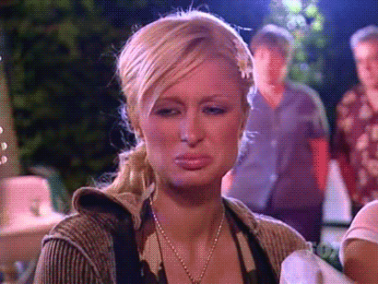
The girl sitting beside you (I think her name is Molly) scrunches her face up at your food and asks – “What is that?”
You explain to Molly that it’s one of your favourite dishes from your country.
You go red in the face and slowly put it back into your bag… how embarrassing.

Slide 18
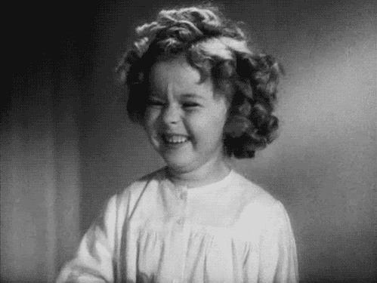
Molly says, “That’s cool! My favourite food from my parents country is Haggis – sounds gross but it’s yummy!” You both laugh and continue eating.

Slide 19
Lunch ends and you put away your food. It’s time to head to music class. Your music teacher Mrs. Sirek seems really nice and starts off the class by asking everyone to share their favourite genre of music.

Slide 20
You hear lots of your classmates mention country, hip-hop, pop, and many more… but no one mentioned your favourite – Bollywood. It gets to your turn – what do you say?
You lie – you say pop music to fit in with your classmates. You don’t love this genre particularly, but you are afraid to share with your classmates.
You tell the truth - you say Bollywood.

Slide 21
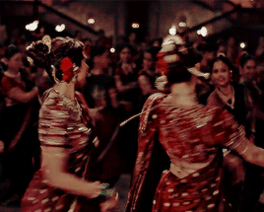
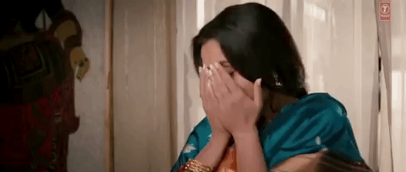
Your classmates look at you in confusion but Mrs. Sirek’s eyes light up. “I think Bollywood music is beautiful Rasmilla! Would you like to share a song on YouTube for the class to hear?”
No – you’re too embarrassed to be put on the spot.
Yes – you pull up your favourite song and to your delight, you classmates start dancing in their chairs – they love it too!

Slide 22
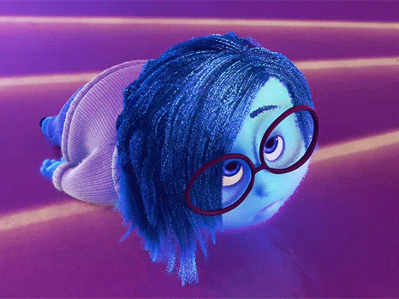
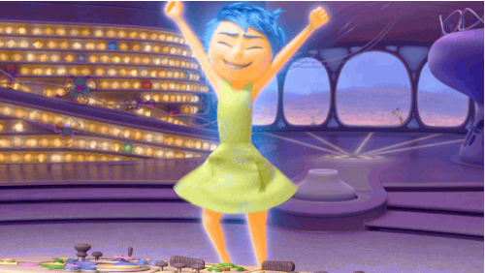
The bell rings once more to signify the end of the day. Everyone packs up and starts to head home. Your teacher pulls you aside and asks you how your first day went. You respond:
“Not so great… I don’t know if I fit in here.”
“It was great! I made some friends and had a wonderful day.”

Slide 23
Your teacher responds, “Things take time. Maybe tomorrow you can try all over again – sometimes going back to the start is a great place to begin.”

Slide 24
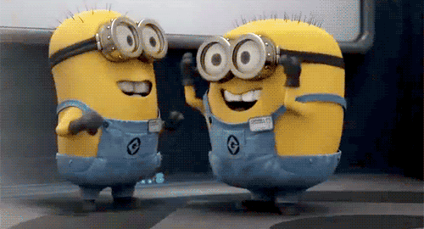
Your teacher responds, “Amazing Rasmilla – I’m so proud of all the effort you’ve made today. Great work – I’m sure you’ll continue to flourish here.”

Slide 25
The End

