Slide 1

The Great Gatsby Pedagogical Tool

Slide 2
Character Development | Metaphors and Similes | Plot | Quotes | Themes, Motifs, and Symbols
$200 | $200 | $200 | $200 | $200
$400 | $400 | $400 | $400 | $400
$600 | $600 | $600 | $600 | $600
$800 | $800 | $800 | $800 | $800
$1000 | $1000 | $1000 | $1000 | $1000

Slide 3
Like Nick, this character comes from the Midwest (North Dakota, although his father later comes from Minnesota). Early in the book, he is established as a dreamer who is charming, gracious, and a bit mysterious. As the story unfolds, however, the reader learns more and more what precipitates the mystery
Notes:
Character Development $200
Answer: Who is Jay Gatsby?

Slide 4
This character is merely a selfish, shallow, and in fact, hurtful, woman. Gatsby loves her (or at least the idea of her) with such vitality and determination that readers would like, in many senses, to see her be worthy of his devotion.
Notes:
Character Development $400
Answer: Who is Daisy?

Slide 5
On one level, this character is the author’s Everyman, yet in many ways he is much more. He comes from a fairly nondescript background. He hails from the upper Midwest (Minnesota or Wisconsin) and has supposedly been raised on stereotypical Midwestern values.
Notes:
Character Development $600
Answer: Who is Nick Carraway?

Slide 6
This character is established from the outset as masculine, aggressive, and, most importantly, dangerous. We also get a much more complete physical description of him than we ever get of Gatsby or Nick, which leaves little room to ever see him in a different, more sympathetic light.
Notes:
Character Development $800
Answer: Who is Tom Buchanan?

Slide 7
This character serves as a representative of the lower class. Through her affair with Tom, she gains entrée into the world of the elite, and the change in her personality is remarkable. She conducts a secret life with Tom, wherein she exhibits all the power and dominance she finds lacking in her everyday life.
Notes:
Character development $1000
Answer: Who is Myrtle Wilson?

Slide 8
A factual imitation of some Hôtel de Ville in Normandy, with a tower on one side, spanking new under a thin beard of raw ivy, and a marble swimming pool and more than forty acres of lawn and garden
Notes:
Plot $200
Answer: What is the Gatsby Mansion?

Slide 9
It’s described as “..their retinas are one yard high. They look out of no face, but, instead, from a pair of enormous yellow spectacles which pass over a non-existent nose."
Notes:
Plot $400
Answer: What is T.J. Eckleberg’s All-Seeing Eyes Billboard?

Slide 10
Although physically bound by the width of the bay, this symbolic item is described as being impossibly small and confusingly distant.
Notes:
Plot $600
Answer: What is the green light?

Slide 11
Bounded on one side by a small foul river, and when the drawbridge is up to let barges through, the passengers on waiting trains can stare at the dismal scene for as long as half an hour
Notes:
Plot $800
Answer: What is the Valley of Ashes?

Slide 12
The less exciting and fashionable of the two peninsulas, people who live here tend to be of lower social class and live modest lifestyles.
Notes:
Plot $1000
Answer: What is West Egg?

Slide 13

“She told me it was a girl, and so I turned my head away and wept. 'All right,' I said, 'I'm glad it's a girl. And I hope she'll be a fool—that's the best thing a girl can be in this world, a beautiful little fool."
Notes:
Plot $200
Answer: Who is Daisy Buchanan?

Slide 14
"I'm going to fix everything just the way it was before," he said, nodding determinedly. "She'll see."
Notes:
Plot $400
Answer: Who is Jay Gatsby?

Slide 15
"They're a rotten crowd," I shouted across the lawn. "You're worth the whole damn bunch put together.”
Notes:
Plot $600
Answer: Who is Nick Carraway?

Slide 16
"Beat me!" he heard her cry. "Throw me down and beat me, you dirty little coward!"
Notes:
Plot $800
Answer: Who is Myrtle Wilson?

Slide 17
"And I like large parties. They're so intimate. At small parties there isn't any privacy."
Notes:
Plot $1000
Answer: Who is Jordan Baker?

Slide 18
“She was extended full length at her end of the divan, completely motionless, and with her chin raised a little, as if she were balancing something on it which was quite likely to fall.” is an example of this.
Notes:
Metaphors and Similes $200
Answer: What is a metaphor?

Slide 19
This simile compares the two, “My incredulity was submerged in fascination now; it was like skimming hastily through a dozen magazines.”
Notes:
Metaphors and Similes $400
Answer: What are incredulity and skimming hastily through a dozen magazines?

Slide 20
“Instead of being the warm center of the world, the _________ ______ now seemed like the ragged edge of the universe.”
Notes:
Metaphors and Similes $600
Answer: What is the middle west?

Slide 21
“At 158th Street the cab stopped at one slice in a long _____ ____ of apartment houses.”
Notes:
Metaphors and Similes $800
Answer: What is a white cake?

Slide 22
“. . . wedging his tense arm imperatively under mine, Tom Buchanan compelled me from the room as though he were moving __________ to another square.”
Notes:
Metaphors and Similes $1000
Answer: What is a checker?

Slide 23
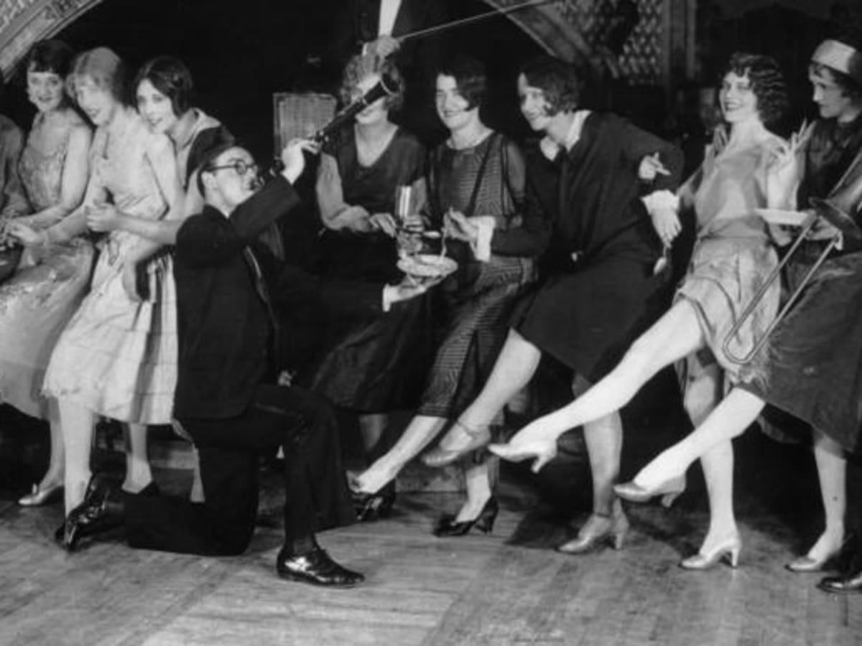
The era described in The Great Gatsby, characterized by the end of prohibition and rapid economic growth.
Notes:
Category $200
Answer: What is the roaring 20s?

Slide 24
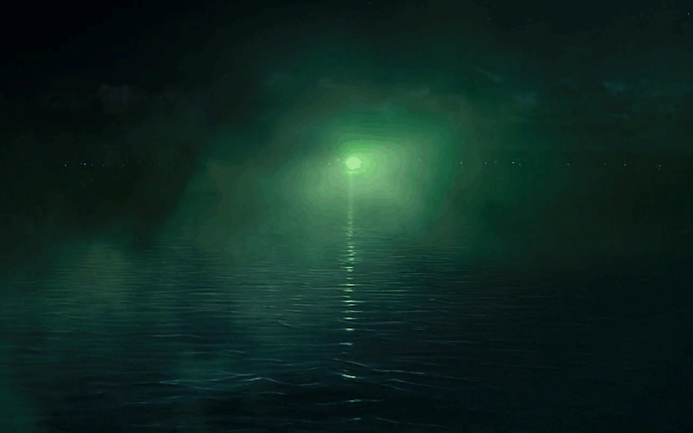
Nick Buchanan compares the green light to this.
Notes:
Category $400
Answer: What is America?

Slide 25
This character is said to come from “old money”.
Notes:
Category $600
Answer: Who is Nick Buchanan?

Slide 26
Nick meets this man before Gatsby’s funeral.
Notes:
Category $800
Answer: Who is Gatsby’s father?

Slide 27
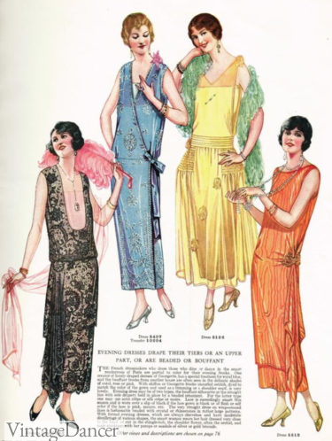
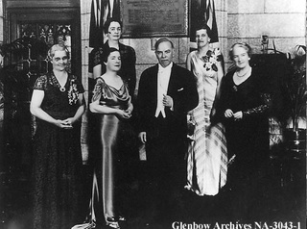
Nick Buchanan describes this group as “hollow”, as represented by Jordan, Tom, and Daisy.
Notes:
Category $1000
Answer: Who are the upper classes?

