Slide 1
A Short Introduction to
Plagiarism

Slide 2
Table of Contents
01
03
02
04
Four Corners
Why Do People Plagiarize?
What do we know about plagiarism?
Reasons why plagiarism occurs and how to amend them
What is Plagiarism?
Activity
Choose your own plagiarism adventure
Definitions and various types

Slide 3
01.
Four Corners: Plagiarism Edition
Please keep this slide for attribution

Slide 4
Four Corners: Plagiarism Edition
To begin class, we are going to play a few rounds of four corners. All of our statements will center around plagiarism. For each sentence read, you will have to either choose to agree, strongly agree, disagree, or strongly disagree with what is being expressed. Once a decision is made, travel to the section of the room which corresponds with your answer. Afterward, we will discuss your choices.

Slide 5
When people plagiarize, they usually do so intentionally.

Slide 6
As long as I cite a source, I cannot be accused of plagiarism.

Slide 7
I do not have to cite a source if I take ideas from another author and put them into my own words.

Slide 8
There are times when plagiarism is necessary.

Slide 9
I can make up a page number if I am using a quotation from another author and I can’t remember what part of the original text I got it from.

Slide 10
I have never plagiarized before.

Slide 11
02.
What is Plagiarism?

Slide 12
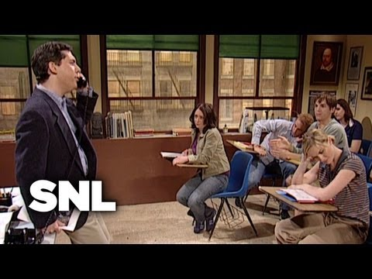
Saturday Night Live
Notes:
https://owl.purdue.edu/owl/avoiding_plagiarism/index.html

Slide 13
“Plagiarism is…
”
using someone else’s ideas or words without giving them proper credit. Plagiarism can range from unintentional (forgetting to include a source in a bibliography) to intentional (buying a paper online, using another writer’s ideas as your own to make your work sound smarter).
Purdue Writing Lab, “Plagiarism Overview,” 1
Notes:
https://owl.purdue.edu/owl/avoiding_plagiarism/index.html

Slide 14
Common Types of Plagiarism Include:

Slide 15
1. Complete/Total Plagiarism
In instances of complete plagiarism, an individual claims the entirety of someone else’s work as their own.
Examples of complete plagiarism include:
A student paying an essay writing service to complete their paper and then submitting it for evaluation
A student handing in an old paper that their friend or sibling had written in a previous school year
Kramer 5, Weber 8

Slide 16
2. Direct Plagiarism
Scenarios of direct plagiarism are very similar to instances of complete plagiarism. The key difference is that the instances of appropriation are reduced to specific sections of the work without citations/acknowledgements
NOT the whole thing.
Examples:
Taking another author’s key idea without any citations
Copying a quotation directly without any quotation marks or acknowledgements
Kramer 7, Weber 10
Notes:
https://www.grammarly.com/blog/types-of-plagiarism/
https://inkforall.com/copy-editing/plagiarism-checker/plagiarism-examples/#1_Total_Plagiarism

Slide 17
Direct Plagiarism Passage Example
Copying a direct quotation:
Student’s Work
Original Research Source
Long ago, when there was no written history, these islands were the home of millions of happy birds; the resort of a hundred times more millions of fishes, sea lions, and other creatures, Here lived innumerable creatures predestined from the creation of the world to lay up a store of wealth for the British farmer, and a store of quite another sort for an immaculate Republican government.
In ages which have no record, these islands were the home of millions of happy birds, the resort of a hundred times more millions of fishes, of sea lions, and other creatures whose names are not so common; the marine residence, in fact, of innumerable creatures predestined from the creation of the world to lay up a store of wealth for the British farmer, and a store of quite another sort for an immaculate Republican government.
Example provided by Bowdoin College 6

Slide 18
3. Paraphrasing Plagiarism
In paraphrasing plagiarism, an individual summarizes another author’s ideas without crediting them. The work is generally similar with just a few words and phrases being changed. Unacknowledged words and phrases usually remain.
Example:
Reading a web page, summarizing everything that the author stated in your own words, and then submitting it without crediting the author
Kramer 8

Slide 19
4. Self-Plagiarism
An author copies/reuses work that they have published/submitted in the past without citing it properly or receiving permission to do so.
Examples:
An author reusing or reworking a text that they curated for a paying client
A student submitting the same paper in multiple classes without receiving permission to do so from their instructors
Kramer 11

Slide 20
5. Patchwork/Mosaic Plagiarism
In patchwork plagiarism, an author “patches” in plagiarized content in with their own original work. This form of plagiarism can be more discrete or work in conjunction with other forms of plagiarism.
Example:
A student using content from a source in a way that cannot count as paraphrasing or common knowledge because keywords from the original source remain
Kramer 13, Bowdoin College 5
Notes:
https://www.bowdoin.edu/dean-of-students/conduct-review-board/academic-honesty-and-plagiarism/examples.html

Slide 21
6. Source-Based Plagiarism
Source-based plagiarism includes instances where a citation is provided by the author, but it is done in an incorrect or misleading manner. This prevents readers from being able to go back to the referenced source and find the cited material. Many times students turn to this form of plagiarism to make it appear as if they have referenced more materials than they actually did for a given task.
Examples:
A writer attributes content that they are using to a source that doesn’t exist
An individual uses a secondary source to collect primary source material but they don’t cite that they collected the material from the secondary source
A student writes a sentence that utilizes multiple sources, but they only cite one from the greater set
An author paraphrases and cites a text without expressing the intended argument or idea captured in the original work
Kramer 15, Quetext 2
Notes:
https://www.quetext.com/blog/source-based-plagiarism-examples-and-how-to-avoid-it-yourself

Slide 22
7. Accidental/Unintentional Plagiarism
Accidental plagiarism is just as it sounds– an individual does not realize that they are plagiarizing another individual’s work due to an unintentional error. Many instructors find that this is the most common form of plagiarism found when students are first learning proper citation practices.
Examples:
An author referencing a commonly used quote without attributing it to the original author (eg. alluding to Barack Obama’s “Yes We Can” speech without citing it)
A student not following an assigned citation practice style
A writer forgetting to use quotation marks when referencing direct material (presenting it as paraphrased material)
Kramer 17

Slide 23
What’s the Big Deal?

Slide 24
Plagiarism can lead to serious consequences at every academic and professional level
Students who plagiarize at the grade school level may be granted a mark of zero on offending assignments
Students who plagiarize at the post-secondary level may face the same consequence or be prone to suspension or expulsion
Professional creators can risk losing their career or be susceptible to legal consequences

Slide 25
03. Why Do
People Plagiarize?

Slide 26

Difficulty with Content/an Assignment

Slide 27
Sometimes when students do not understand the academic content within a given unit, or how to complete an assignment, they may turn their efforts to copying the work of others instead of focusing on how to improve their comprehension and skill level in the area.

Slide 28
How Can We Resolve This?
Students can arrange a conferencing period with their instructor where areas of confusion can be clarified
If students do not understand the way their instructor explains the given material, they can turn to other sources (eg. websites, other instructors, tutors, peers, books from the library, textbooks) for additional means of delivery and then reference them in their work
Students can work on further developing their metacognitive skills to better assess and communicate their struggles to their instructors early on so plagiarism seems less appealing or necessary

Slide 29

Time Management Issues

Slide 30
Periodically, students will plagiarize because they did not use their work periods in a beneficial manner. Time is up, the assignment is due, and, because of stress, they take someone else’s work so that they can still produce a product.

Slide 31
How Can We Resolve This?
Students can reflect on if there are factors that are driving procrastination (eg. anxiety, perfectionism, disinterest), communicate them to their instructor, and then the pair can work to find a solution
Students can ensure that they have completed required fragments of their assignments that are due on checkpoint days (eg. planners, proposals, thesis statements, rough copies, good copies)
Students can work independently, with their peers, or with their instructor to make a schedule that helps them determine proper time allocation to complete their assignments
Students can communicate with their instructor if they require accommodations or an extension

Slide 32

Extenuating Circumstances

Slide 33
Sometimes we have good intentions of finishing an assignment, but then life gets in the way. Amid other forms of stress, school can become our last priority. In these situations, plagiarizing someone else’s work may be tempting so we can “just get the assignment out of the way.”

Slide 34
How Can We Resolve This?
Keep communication lines with your instructor open
  Teachers are people too, and we understand that school does not always come first
  If you are struggling and need help, options for accommodations (such as extensions or extra assistance) are always available
Remember: an assignment that comes in late is always better than a stolen one.

Slide 35

Lacking Citation Proficiency

Slide 36
As we discussed earlier, many students plagiarize accidentally because they are still becoming familiarized with proper citation practice.

Slide 37
How Can We Resolve This?
Students can ask their instructor to clarify any questions they may have with general citation practices or to check to see if their citations are formatted properly
Students can ask their peers for assistance
Students can consult external writing assistance services and resources (eg. the OWL Purdue Online Writing Lab or Citation Machine)

Slide 38
Additional Rules to Follow:
If a point you are making in your work is common knowledge (eg. the general public knows the information and can accept it without proof) and it is presented in your own words, you do not need a citation
If you are taking any specific ideas from an author (not just restricted to print), you will need a citation
If you are utilizing the direct words of an author (generally 3 or more) or their specific terminology/theory on the subject, you will need a direct quotation and a corresponding citation

Slide 39
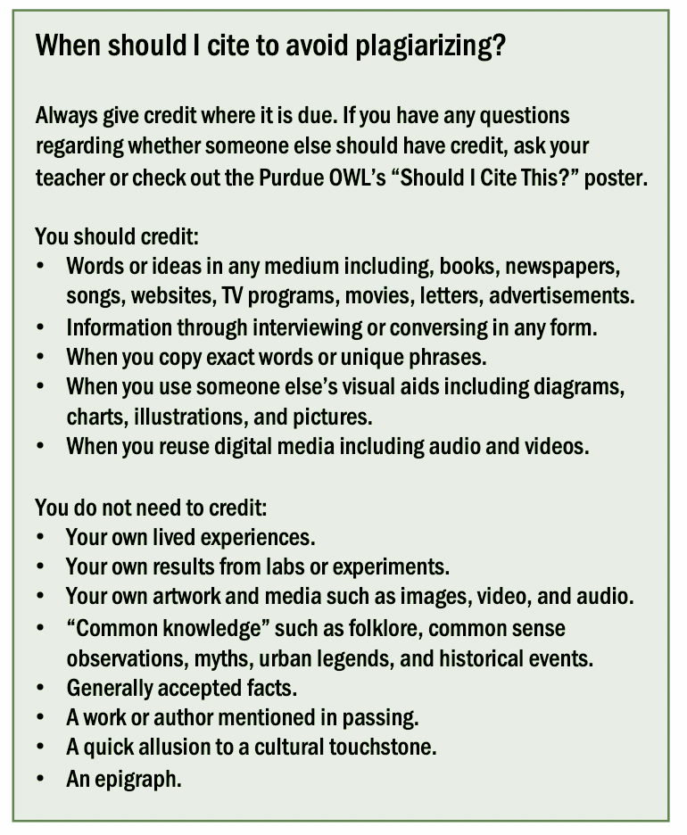
Figure: OWL Purdue, “Avoiding Plagiarism,” 1
Notes:
https://owl.purdue.edu/owl/avoiding_plagiarism/documents/plagiarism_one_pager.pdf

Slide 40

Lack of Confidence

Slide 41
Sometimes students feel tempted to take work from another author because they feel as if their own ideas are not sufficient. There are several reasons why this may occur.
Notes:
https://owl.purdue.edu/owl/english_as_a_second_language/esl_students/plagiarism_and_esl_writers.html

Slide 42
Imposter Syndrome
Imposter syndrome is a term which is used to describe the feeling of not belonging in any given classroom
  One may feel out of place, not good enough, not smart enough, or as if they are going to be “discovered” at any time for being one of these things
  This can be further enhanced in competitive classroom environments
Unfortunately, imposter syndrome most often impacts marginalized individuals (eg. racialized students, students with disabilities, neurodivergent students/students with anxiety, students living in poverty, students who belong to a gender minority)
  This is because academia often gives amplification and priority to those with sociocultural privilege (eg. white, able-bodied, heterosexual, wealthy, or male individuals)
  The system failing can make someone feel out of place or as if they are personally failing

Slide 43
Discomfort with Academic Language and Field-Specific Jargon
“According to scholars like Pat Currie and Alastair Pennycook, writers new to the English language might copy language from published works in order to cope with their challenging learning situations and busy academic schedules”
Proficient English speakers may also struggle with niche terminology in a particular subject area
  Instead of trying to decipher different concepts or what an author is stating, it can be tempting to acquire a passage without attribution
Owl Purdue, “Plagiarism and ESL Writers” 1

Slide 44
How Can We Resolve This?
Trust that your work has merit and that your academic perspectives matter
  Your instructors value your views and want to read about how you see and read the world more than they want to watch you summarize or steal someone else’s perspective
Ask for help
  If you need help with particular forms of academic language your teacher would love to assist you
Work with your classmates and instructor to make the classroom a more inclusive space that encourages the voices and opinions of others

Slide 45
Also remember…
It is okay if we don’t feel confident in our own ideas and we want to reference what others are saying. We just have to remember to cite what was expressed by the other author properly and make our own contributions/provide feedback to their work in our own words thereafter.

Slide 46

Disinterest in Material

Slide 47
Sometimes students plagiarize because they don’t like an assignment, the content is not interesting to them, and they “just want the whole thing to be over.”

Slide 48
How Can We Resolve This?
Disinterest is a serious concern that does not often get discussed at the high school level
  Your instructors don’t want you to have to complete an assignment that you are not passionate about
Students can work with their instructor to try to find an aspect or angle within an assignment that will make it more interesting to them

Slide 49

Problematic Cultural Norms/Appropriation

Slide 50
In colonial education systems, sometimes students with privilege think that it is okay to reference the stories of marginalized students, when speaking or writing on topics like intersectionality, without citing them.

Slide 51
In doing so, said individuals take advantage of the intellectual and emotional labour that marginalized students take part in.

Slide 52
Fallen Matthews speaks to the frustration this creates in “Nobodies to Everybody: How Plagiarism Pervades Marginalized Students”
“Currently, I’m the only racial minority in my classes–and I’d be lying if I said I felt happy whenever I peeped people noting points or references I bring up [without credit]. I mention things like intersectionality, kyriarchy, and even privilege– only to see it scribbled down, shrugged off, then parroted [incorrectly] and applauded in presentations.”
Matthews 7
Notes:
https://modelviewculture.com/pieces/nobodies-to-everybody-how-plagiarism-pervades-marginalized-students

Slide 53
How Can We Resolve This?
Credit your peers when they talk about their experiences
If you are a part of a privileged group, take time to reflect on the effort your classmate is taking to perform these forms of emotional and intellectual labour
Think about if it is appropriate to repeat a story that is not your own

Slide 54
Reflect: “I have never plagiarized before.”

Slide 55
04.
Activity
Please keep this slide for attribution

Slide 56
Works Cited
Bowdoin College. “Academic Honesty and Plagiarism.” Office of the Dean of Students, https://www.bowdoin.edu/dean-of-students/conduct-review-board/academic-honesty-and-plagiarism/index.html. Kramer, Lindsay. 7 Common Types of Plagiarism, with Examples, Grammarly, 2 June 2022, https://www.grammarly.com/blog/types-of-plagiarism/. “Nobodies to Everybody: How Plagiarism Pervades Marginalized Students.” Model View Culture, https://modelviewculture.com/pieces/nobodies-to-everybody-how-plagiarism-pervades-marginalized-students. Purdue Writing Lab. “Avoiding Plagiarism.” Purdue Writing Lab, https://owl.purdue.edu/owl/teacher_and_tutor_resources/preventing_plagiarism/avoiding_plagiarism/index.html. Purdue Writing Lab. “Plagiarism and ESL Writers .” Purdue Writing Lab, https://owl.purdue.edu/owl/english_as_a_second_language/esl_students/plagiarism_and_esl_writers.html. Purdue Writing Lab. “Plagiarism Overview .” Purdue Writing Lab, https://owl.purdue.edu/owl/avoiding_plagiarism/index.html. Quetext. “Source-Based Plagiarism: Examples and How to Avoid It Yourself.” Quetext Blog, 28 Dec. 2021, https://www.quetext.com/blog/source-based-plagiarism-examples-and-how-to-avoid-it-yourself. Saturday Night Live. “Plagiarism.” YouTube, 16 Aug. 2013, https://www.youtube.com/watch?v=yDxN4c_CmpI& t=44s. Weber, Pam. “5 Common Plagiarism Examples to Know and Avoid.” Ink for All, 1 Sept. 2022, https://inkforall.com/copy-editing/plagiarism-checker/plagiarism-examples/#1_Total_Plagiarism.

