Slide 1






Saw the aurora.
+1 star
Nunavut
Nova Scotia
Enjoyed the seafood.
+1 star
Newfoundland
Northwest Territories
Prince Edward Island
1
2
Yukon Territory
New Brunswick
6
3
Q: Which province’s capital locate Pacific Coast?
A Newfoundland
B New Brunswick
C Nova Scotia
D British Columbia
Q: Which province and territories is close to the Great Lakes?
A Nunavut
B Yukon
C Michigan
D Ontario
Q: In which province and territory is the highest mountain in Canada?
Q: Capital of Quebec?
A Quebec city
B Montreal
C Gatineau
D Edmonton
Q: Flower of Alberta?
Q: Which province bird is Shar-tailed Grouse?
A Ontario
B Manitoba
C Saskatchewan
D Nova scotia
Q: What is the capital of New Brunswick?
Q: What is Canada's smallest province?
Q: Which two provinces face the Atlantic Ocean?
5
4
Quebec
Forgot to bring the umbrella.
- 1 star
Ontario
British Columbia
Alberta
Manitoba
Saskatchewan
START

Slide 2
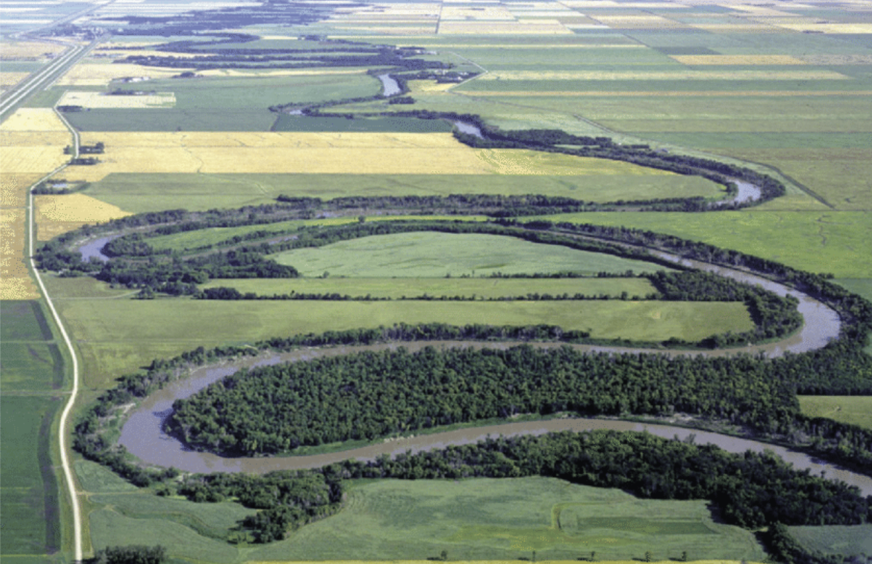
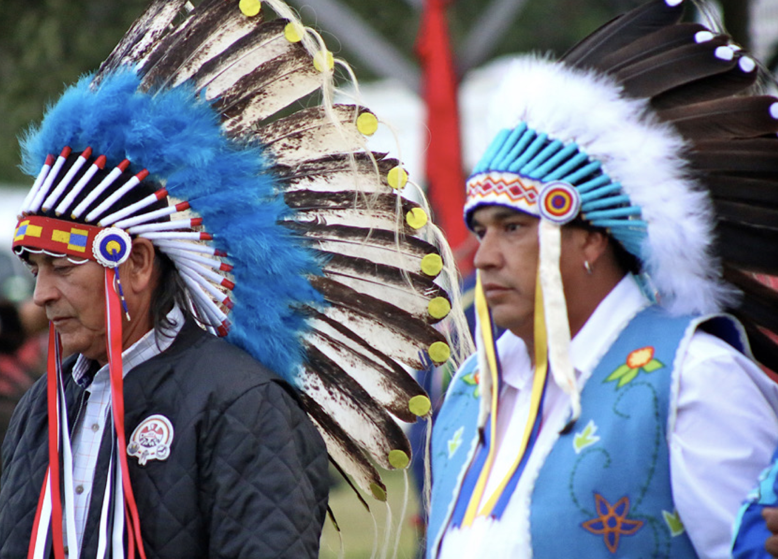
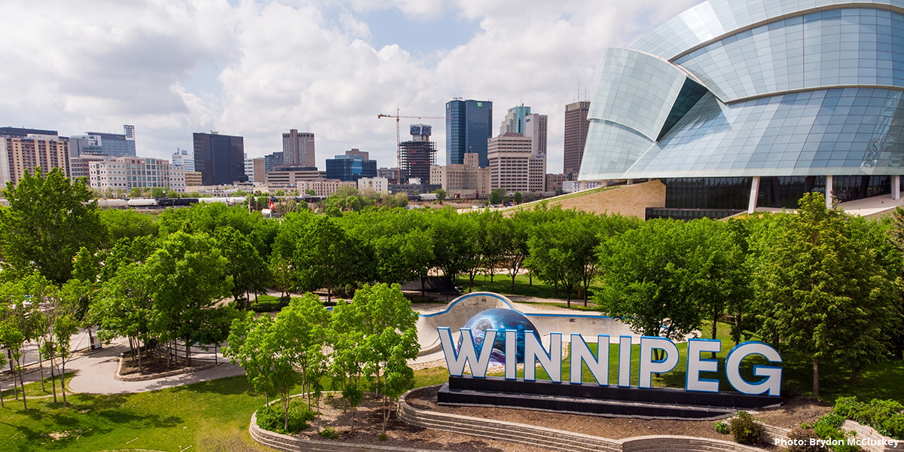
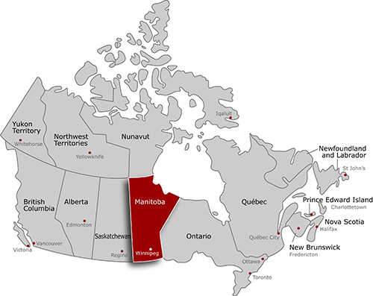
Manitoba
The Keystone Province
Manitoba Cities & Towns | MB Interest & Facts & Maps (canadianonly.ca)
plains
63 First Nations in the province and five indigenous linguistic groups. The languages are Nēhiyawēwin, Ojibwe, Dakota, Oji-Cree, and Dene.
Central Canada
Topography: Predominantly plains, cut by rivers, lakes and glacial remnants.
Climate: Extreme continental
Economy: Agriculture, mining, hydroelectric power and manufacturing. Due to the black soil, agriculture is the largest sector and Manitoba has 12% of Canada's farmland. The main crops are various grains (19.0%) and oilseeds (7.9%).
Capital: Winnipeg
Manitoba Cities & Towns | MB Interest & Facts & Maps (canadianonly.ca)

Slide 3
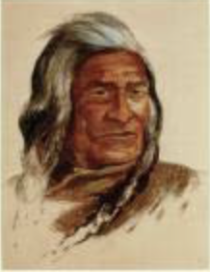
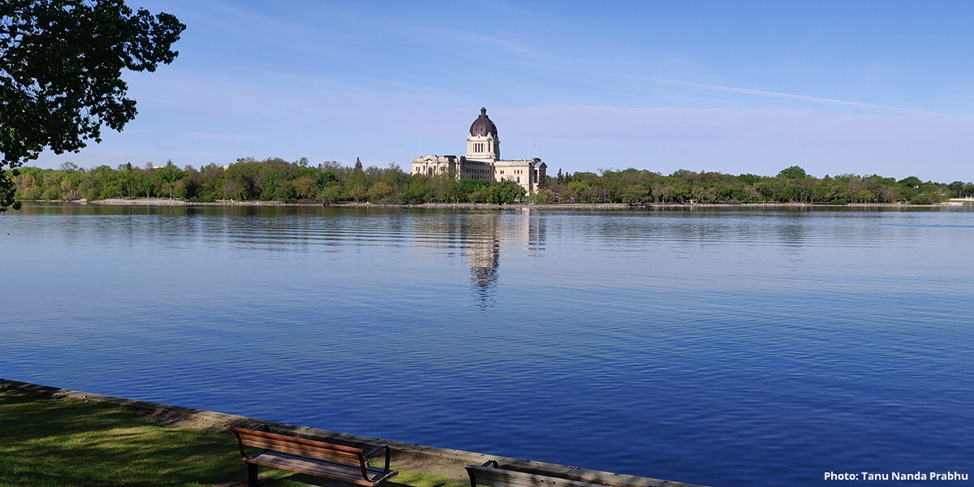
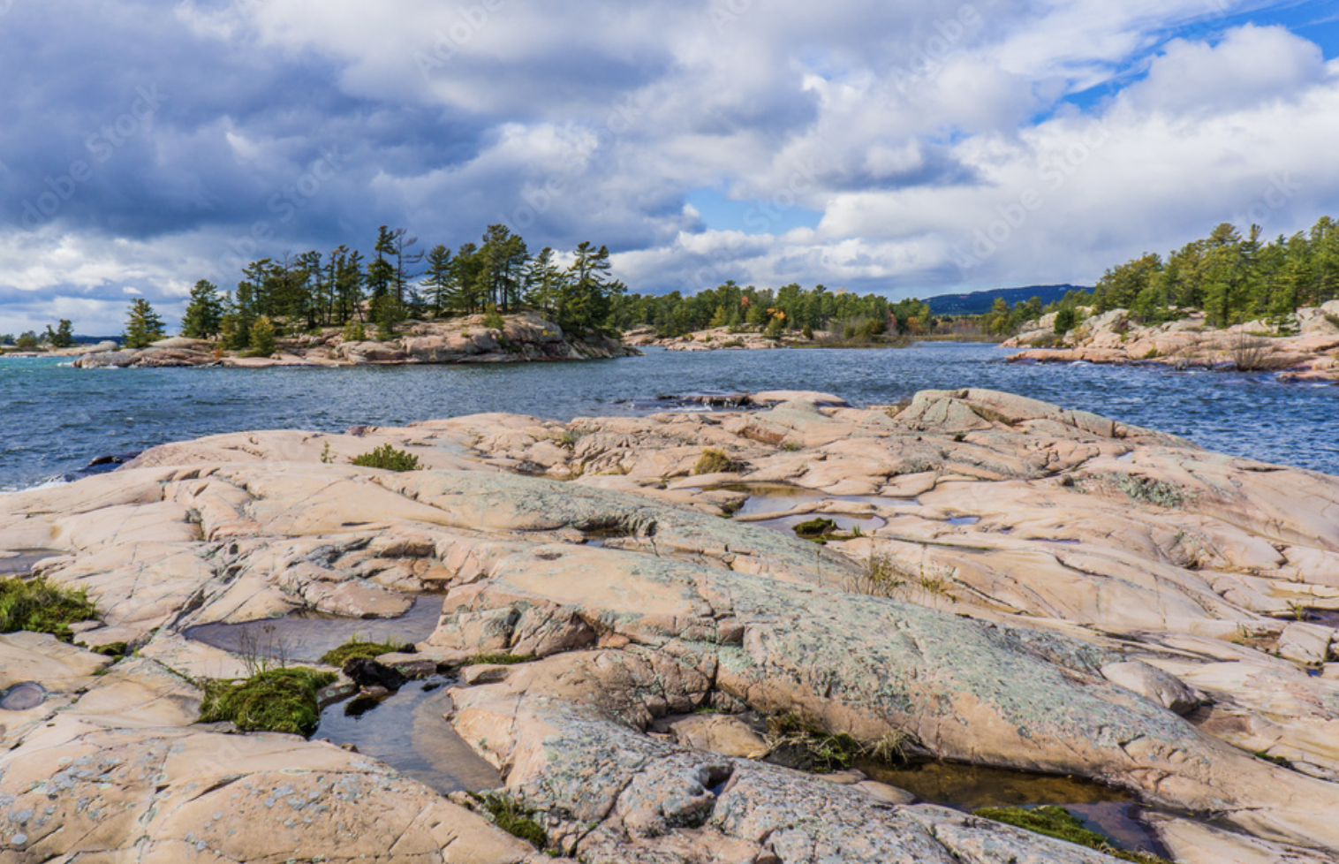
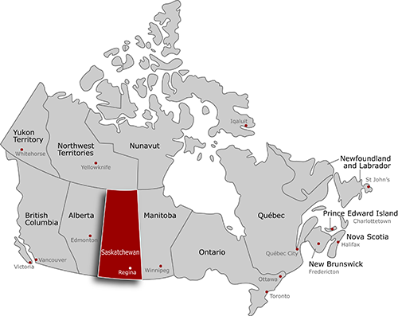
Saskatchewan
Saskatchewan Cities & Towns | SK Interests & Facts & Maps (canadianonly.ca)
which means “swiftly flowing river”.
Canadian Shield
First Nations ethnicities in the province include the Cree, Assiniboine, Saulteaux, Lakota, Dene and Dakota.
Central Canada
Topography: Saskatchewan has two main geographical regions: the Canadian Shield in the north and the Interior Plains in the south.
Climate: Continental climate in the central and eastern part of the province. Semi-arid steppe climate in the south and southwest.
Economy: Agriculture, mining and energy. The main crops are wheat.
Capital: Regina
Saskatchewan Cities & Towns | SK Interests & Facts & Maps (canadianonly.ca)

